Slide 1

ANALYSIS OF ABSOLUTE RESULT ’ S PRIVATE SALE EVENTS FOR CHEVROLET
FALL 2015
ABSOLUTE RESULTS PRODUCTIONS, LTD
1

Slide 2
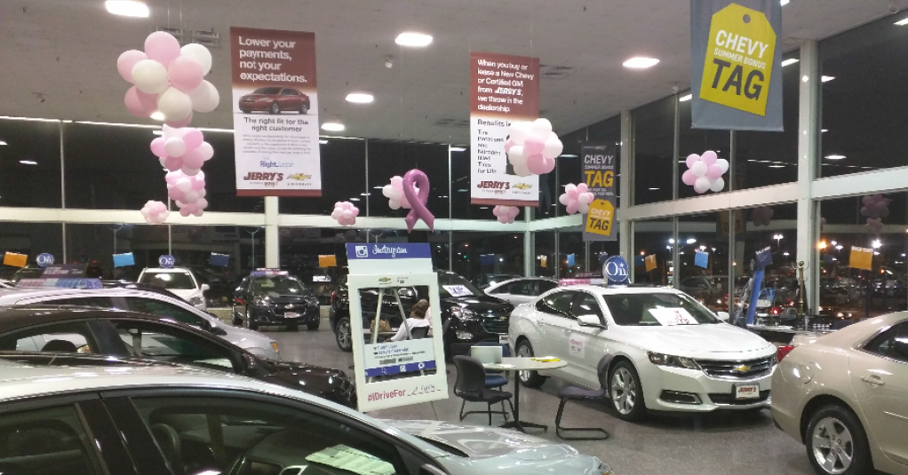
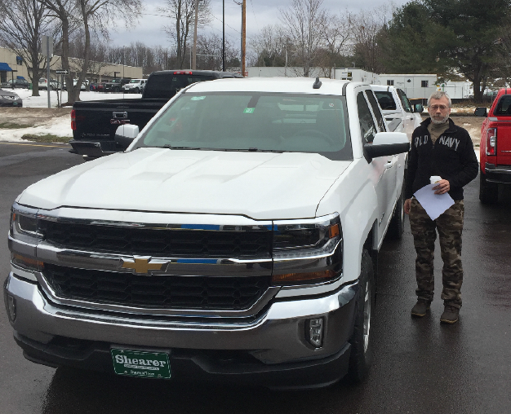
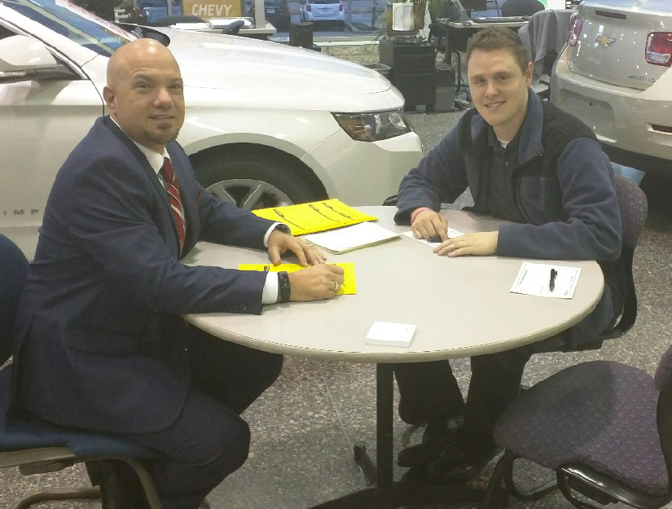
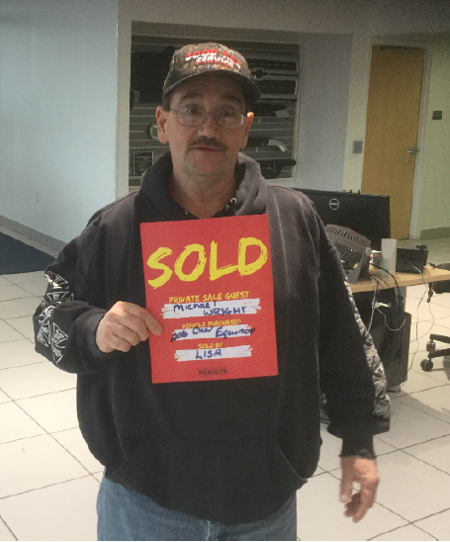
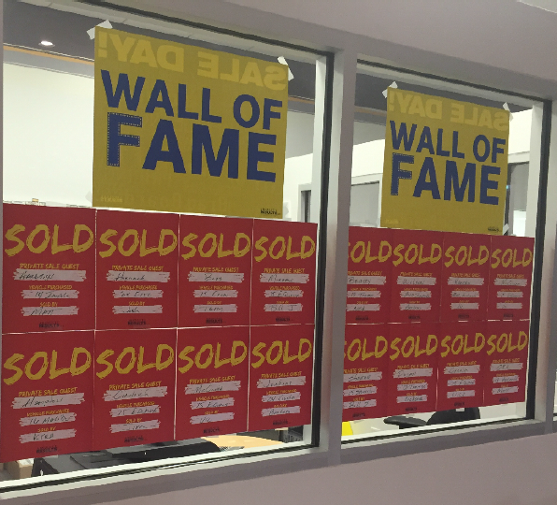
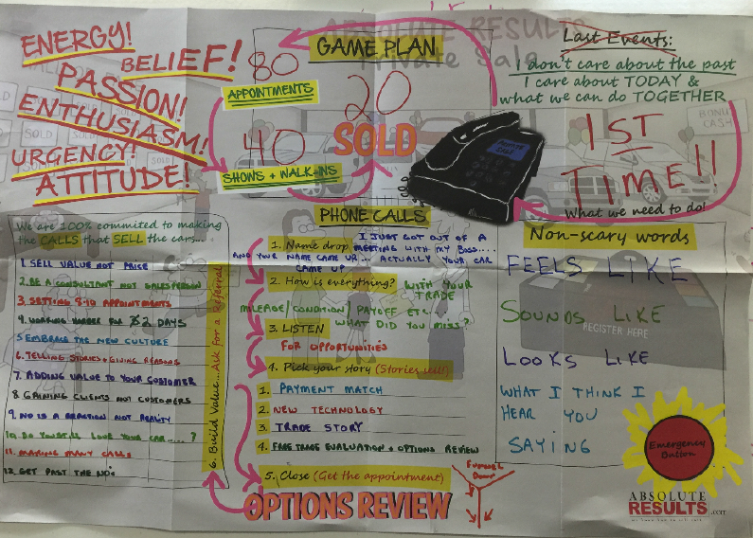
The Chevrolet Private Sale Events Highlights
215 vehicles were sold at events over the months of October through current by 11 unique Chevrolet dealers in 12 events stretched across the north eastern US states
New vehicle sales were the tune of the month representing 73% of sales
For the top single event, Shearer Chevrolet Buick GMC and Johnson Motors tied with 24 vehicles each
For overall sales, Crivelli Chevrolet Buick was the winner at 26 over 2 events
The Trade-Up invites worked well with 37% of the trade in vehicles coming from the last 3 model years
The conversion rates for appointments into attendees was 49% while the conversion into buyers from attendees was 52%
A total of 134 Trade-ins to provide inventory for future used vehicle sales
ABSOLUTE RESULTS PRODUCTIONS, LTD
2

Slide 3
How many customers purchased?
A total of 215 vehicles were sold through the months of Oct to current at Private Sale events (12).
3

Slide 4
Which Dealer stood out?
New
Used
24
24
22
Overall average for the sales is 18 per event.
There is a tie at the top between Shearer Chevrolet and Johnson Motors both getting 24 sales at their events.
Crivelli Chevrolet held 2 events with a total of 25 sales coming out top overall.
22
21
20
18
15
15
13
11
10

Slide 5
How many of the customers were new to the Dealer?
33% of the Attendees to a Private Sale Event were NEW to the Chevrolet dealer visited
41% of the Buyers at a Private Sale Event were NEW to Chevrolet dealer purchased at
80% of the loyal Chevrolet owners who attended a Private Sale Event bought another Chevrolet
ABSOLUTE RESULTS PRODUCTIONS, LTD
* Incomplete Data therefore not included in All Dealer Numbers
4

Slide 6
Conversion – Appts to Shows to Buyers
Weaker Appts to Shows
Strong Attendees to Buyers
Strong Appts to Shows
Strong Attendees to Buyers
Which Dealer had the best conversion rate from Attendees to Buyer?
The overall rate for converting appointments into attendees was 49%
The overall rate for converting attendees into buyers of a new vehicle was 52%
Armen had the highest conversion rate for attendees into buyers - 68%
Average 52%
Weaker Appts to Shows
Weaker Attendees to Buyers
Strong Appts to Shows
Weak Attendees to Buyers
Average 49%
5

Slide 7
Top 15 Brands Buyers Currently Owned
Based on 194 Verified Sales
Brand Loyalty
61% of the buyers were currently driving a Chevrolet
16% of the buyers first time vehicle
16% of the buyers were converted from another non GM brand
Additional 4% from misc. brands
Based on Sales as collected by Absolute Result Trainers at the end of each event with an 87% accuracy
ABSOLUTE RESULTS PRODUCTIONS, LTD
.
6

Slide 8
Top New Models Sold
New
What models did they buy ?
The Silverado 1500 was the #1 New and the #1 Used vehicle sold
Chevrolet brand represented 75% of the used vehicles sold
Top 10 Used Models Sold
Used

Slide 9
Trade Ins - how old were they?
Sweet
Spot
16% of the trade ins were converts from another non GM brand
Trade Up Events are working – 49% of the trade in were 2 to 4 years old
2013 model years was the largest single category at 27%

Slide 10
We help sales people sell cars!
Top Ten Sales Representatives
Top Sales Person:
Todd Clark of Adirondack Chevy Buick sold 7 vehicles
Adirondack Chevy Buick had 2 salespeople in the top 10

Slide 11
Chevrolet Loyalty Opportunity!
Existing in the Dealers’ database are:
Chevrolet A/B Owners 69,292
12 Events were held
31,250 invites
Still Available for 2016
83,832
Total Chevrolet Owners: 115,082
Grade A-Loyal: 54,031
Grade B-Defector: 15,261
Grade C-Lost: 32,259
Each Dealer, on average, has 10,462 Total Chevrolet Owners
Grade A-Loyal: 4,911
Grade B-Defector: 1,387
Grade C-Lost: 2,932

Slide 12
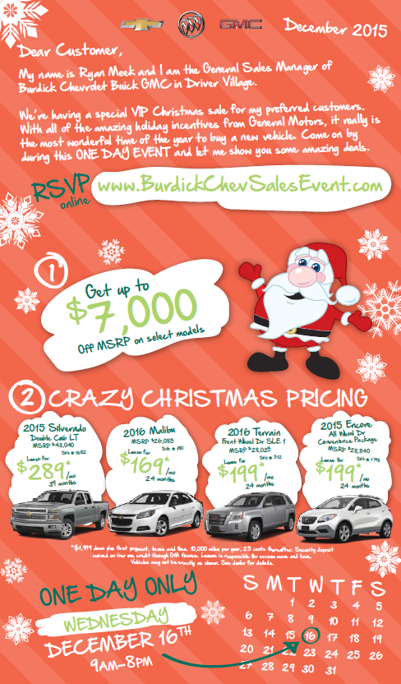
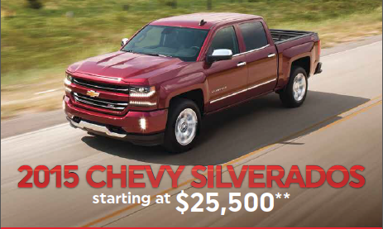
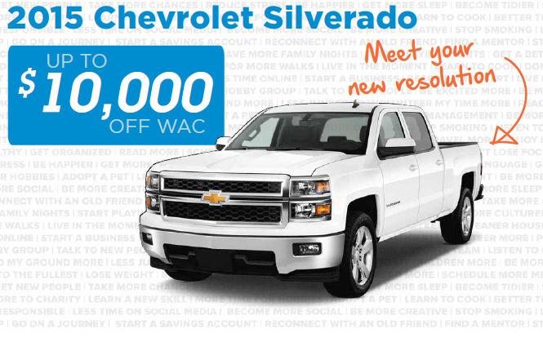
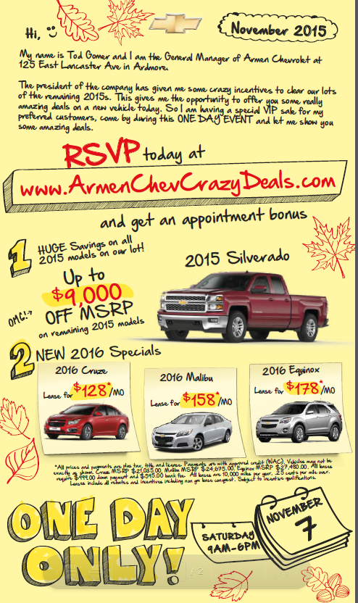
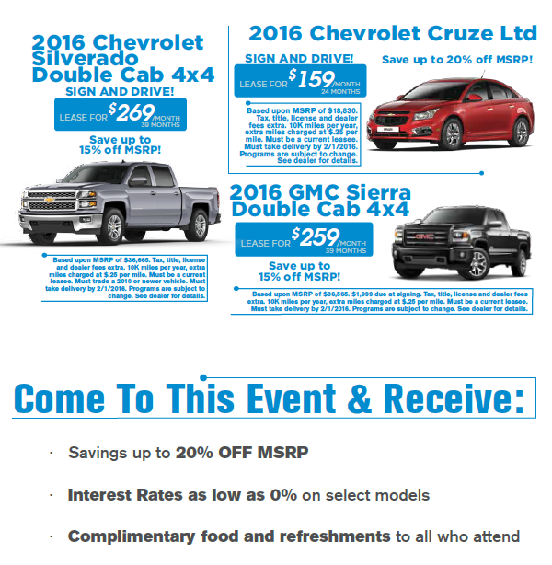
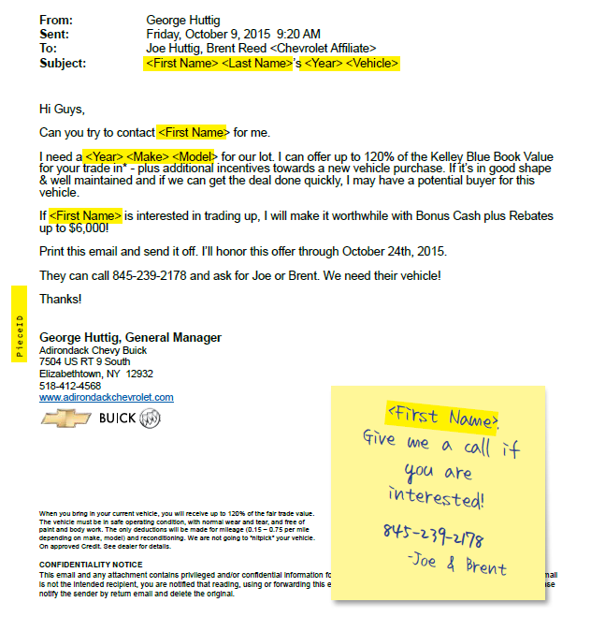

Summary:
3,1250 Invitations mailed
680 Appointments booked
415 Total Customers registered
61 Walk Ins
215 Sales
Overall (new and used), 52% of people who visited the showroom purchased on sale day!
Moving forward:
Increase the number of appointments
Still have 83,832 Chevrolet customers we can mail to – enough to hold 16 events

Slide 13

Contacts
Scott Thompson
Gerry Barton
Shane McIntosh
ABSOLUTE RESULTS PRODUCTIONS, LTD
14

